Slide 1
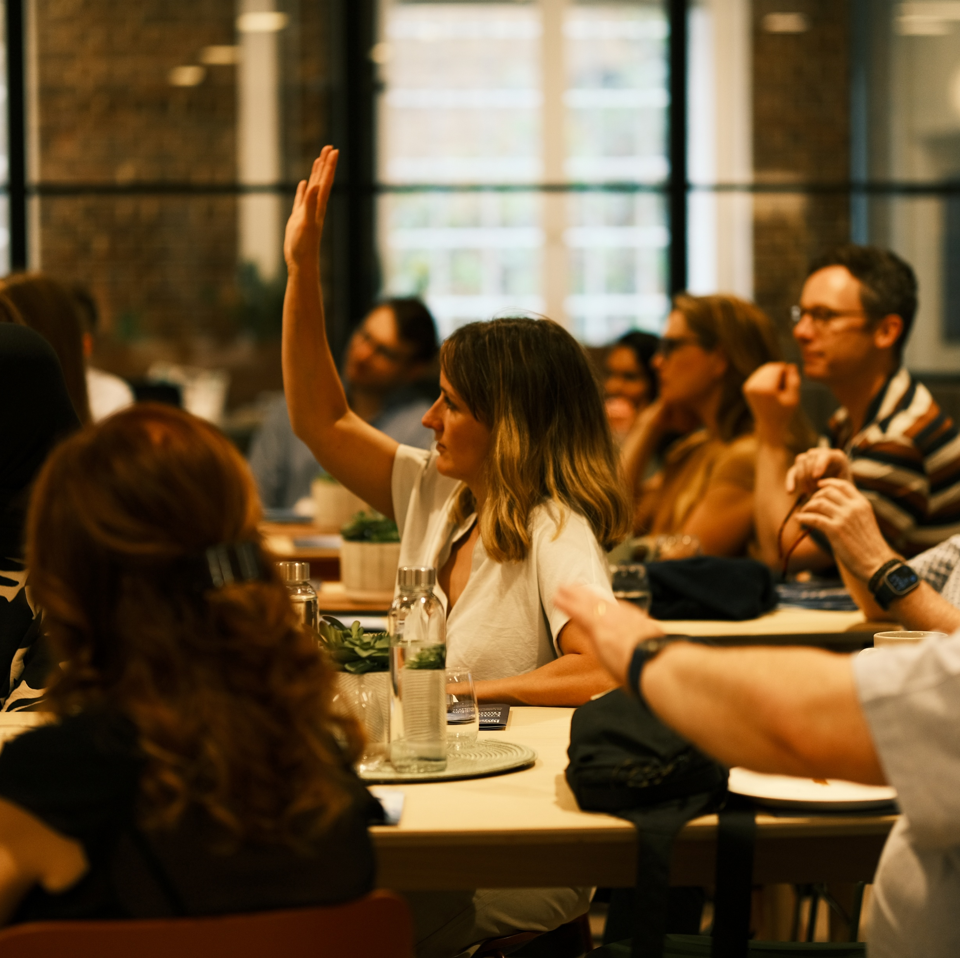
UNCOMMON RESULTS MASTERMIND
Enrolment closes Jan 31st

Slide 2
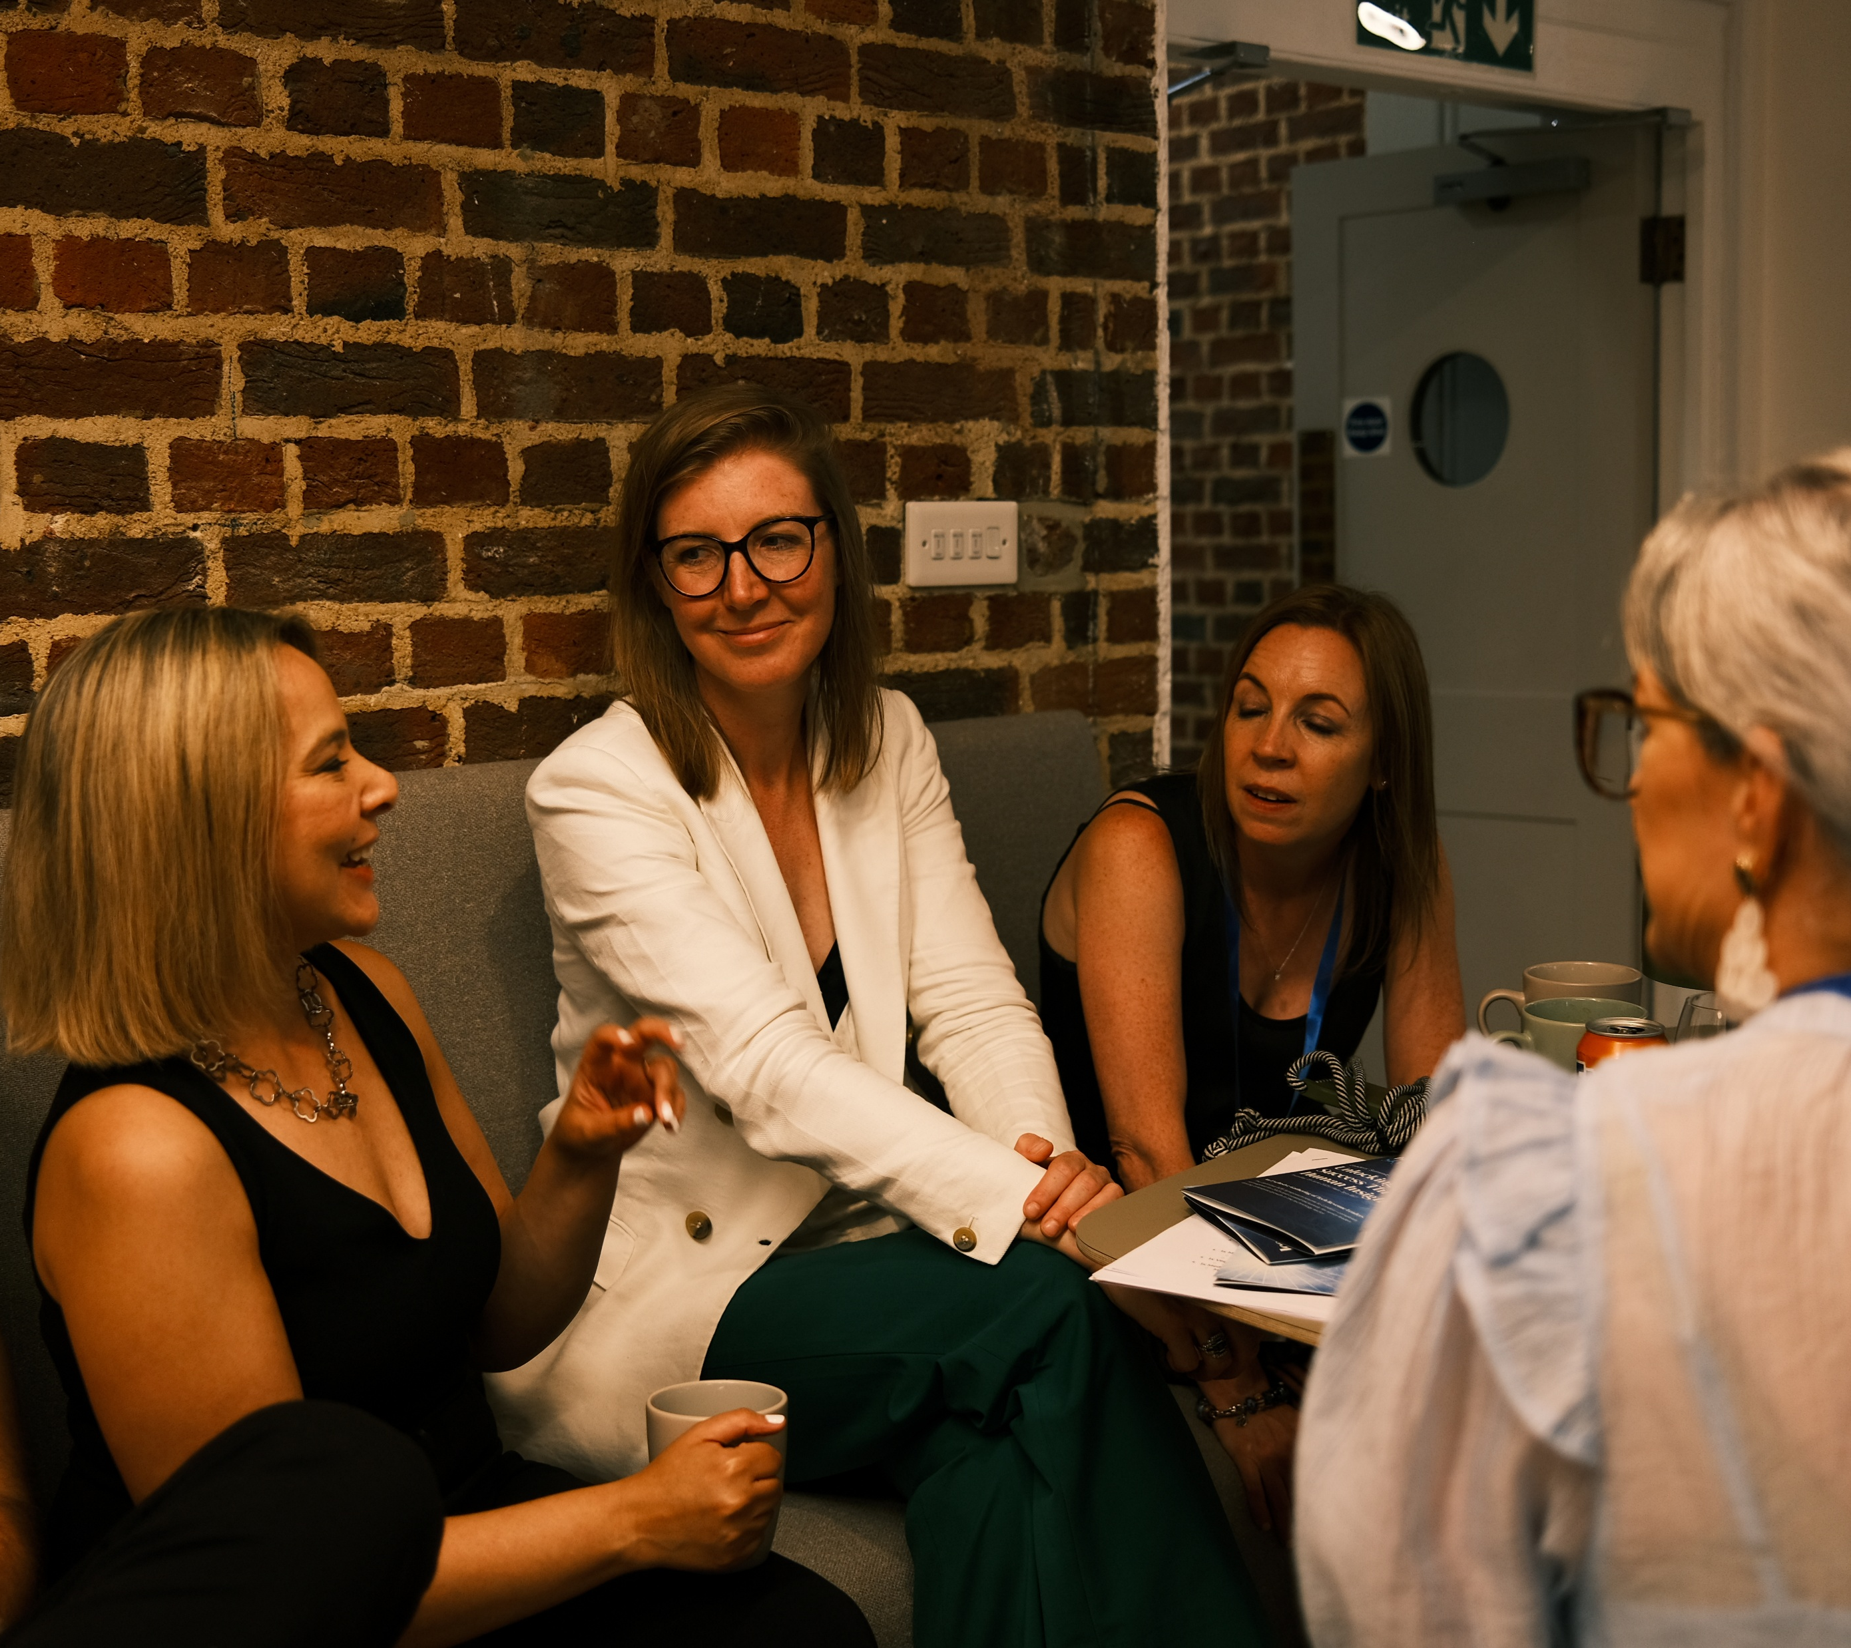
WHAT IS IT?
Based on my Uncommon Results MethodTM, this is an intimate mastermind like no other.
Join a small group of like-minded business owners to share ideas, support each other and get guidance and high value content from Ilse Passet.
Building and growing a business takes time and it can sometimes feel lonely, disheartening or hard.
This is the type of support I wish I’d had when I first started my business 10 years ago and today, I want to invite you to join in this adventure and:
Build a sustainable business with a consistent stream of clients
Start building unstoppable confidence
Get support from a like-minded community
See you there,
Ilse

Slide 3




Mastermind Programme – what’s included
18+-Group Coaching Calls – value £11,500
Online Group – Value £150
Resources Library - Value £9,000
6-months Total Value - £32,210

Slide 4
Topics Included – to be confirmed
Mindset Mastery
Learn how your brain works and rewire it for success
Sales and Marketing Fundamentals
Set up your business so you can start getting clients right away
Money Mindset
Eliminate mindset blockers and rebuild your relationship with money
Beat Impostor Syndrome
Learn how to recognise and beat impostor syndrome
Confidence Mastery
Increase your confidence levels so you can make the best decisions for your business
Resilience Mindset
Learn how to stay in a powerful state so that you can run your business from a place of love not fear

Slide 5

READY TO SIGN UP?
Join the Mastermind | Ilse Passet Coaching
Questions? Email coaching@ilsepasset.com

Slide 6
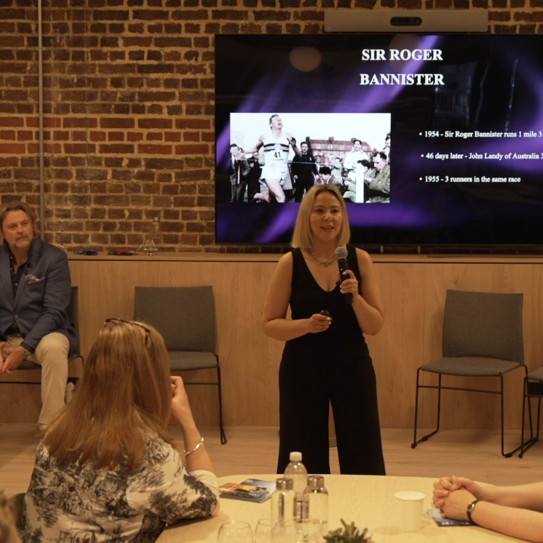
CONTACT ME
coaching@ilsepasset.com
www.ilsepasset.com
LinkedIn – Ilse Passet
YouTube – Uncommon Results

